Slide 1

Employee Performance Rating using ML

Slide 2
Team Members: Divya Chilukuri - 700744169 Manideep Donthaveni - 700740574 Raj Kumar Samudrala - 700731662

Slide 3
Role/Responsibilities
Name | Responsibility
Divya Chilukuri | Data collection , Examining the data and cleaning of the data
Manideep Donthaveni | Exploratory Data Analysis and Machine learning Modeling
Raj Kumar Samudrala | Model Evaluation and Documentation

Slide 4
Motivation
The task of predicting employee performance for promotions and raises is challenging for human resource officers and management.
To address this, a proposed solution involves utilizing machine learning techniques.
The organization analyses employee ratings using various attributes, including project reviews, customer comments, and client satisfaction levels, to assess personnel performance.

Slide 5
Objectives
The objective of the project is to enhance company productivity through the examination of employee ratings.
The organization gathers a dataset that includes employee categories and their official information, such as project evaluations, feedback, project status, and client feedback.
Then analyses employee ratings using various attributes, including project reviews, customer comments, and client satisfaction levels, to assess personnel performance.

Slide 6
Problem Statement
Enhancing company productivity through effective evaluation of employee ratings is crucial for software companies. However, the current process lacks efficiency and a comprehensive approach.
The organization possesses a dataset with employee categories and relevant information, including project evaluations, feedback, project status, and client feedback.
To address this, we need a solution that analyzes employee ratings using project reviews, customer comments, and client satisfaction levels, enabling a qualitative assessment of personnel performance.

Slide 7
Proposed Solution:
Our Proposed model not only reduces the assignment value and human’s effort however also provides a foundation for challenge managers to qualitatively evaluate the overall performance of every member in the organization.
The employee ratings are provided based on the project reviews, client feedback and client satisfaction level about the project.
The main significance of the project is the employee rating productivity improvement will be the python based application which contributes to imporve the production of the software company.
It will be helpful to the software company to imporve the skills of the employee based on the project requirements and also to improve the company productivity level.

Slide 8
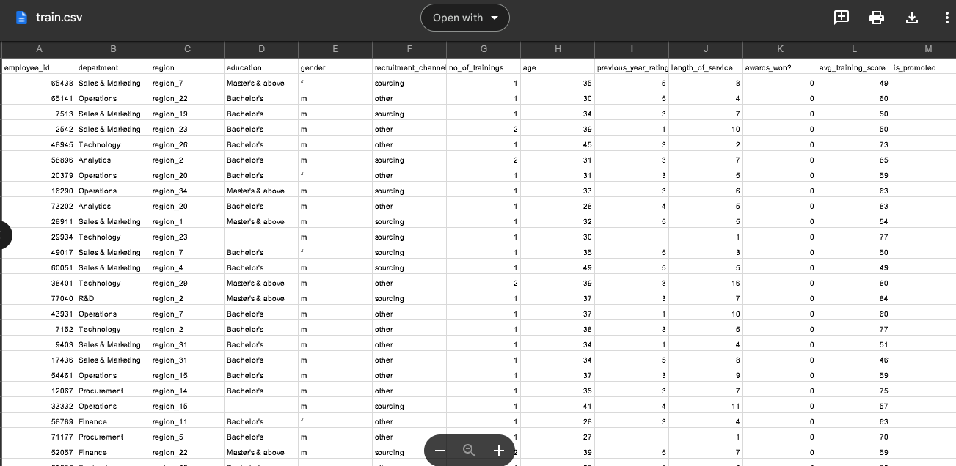
Dataset
train.csv
This file contains the dataset is the training set for the employee performance.

Slide 9
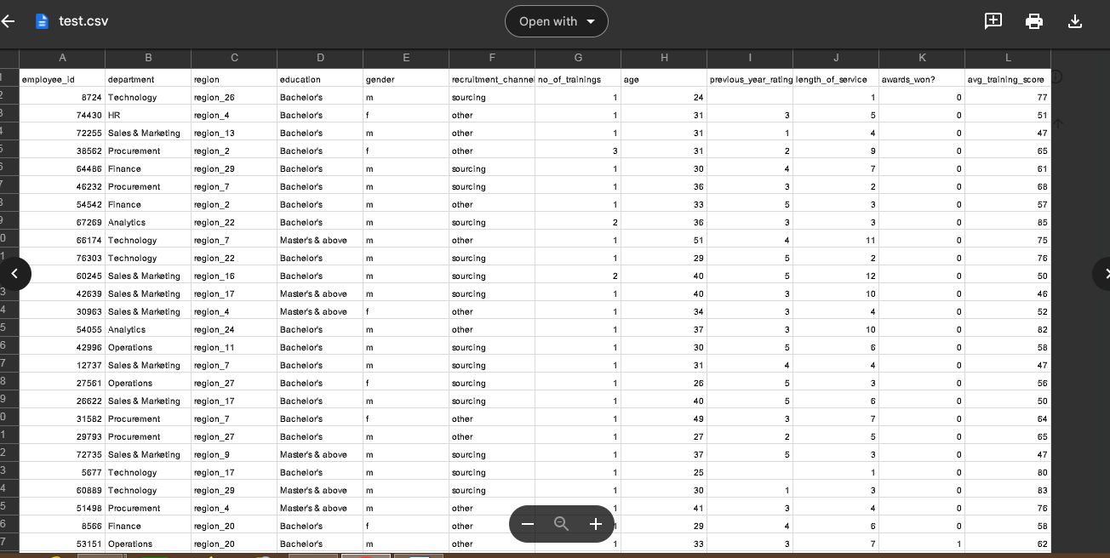
test.csv
The testing dataset is used for the evaluation of the machine learning algorithm is stored in test.csv

Slide 10
Analysis of Employee Performance
1) Dataset collection
2) Data cleaning
3) Exploratory Data Analysis
4) Machine learning Modeling
5) Documentation

Slide 11
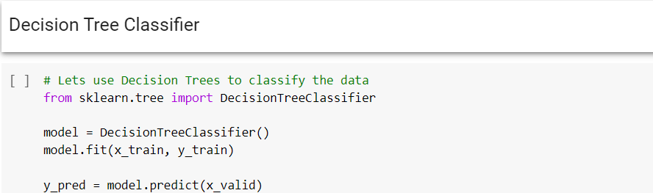
Results & Simulations
Machine Learning Predictive Modelling
The Decision Tree classifier is applied for the employee performance rating system.
The algorithm is executed, and the accuracy is calculated

Slide 12
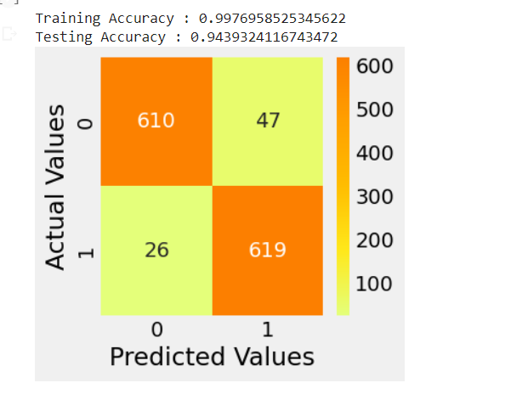
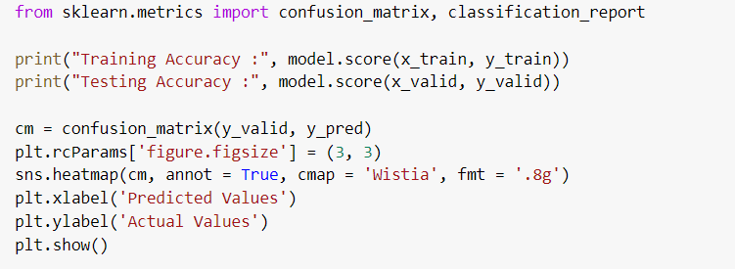
Results:

Slide 13
References:
[1] Kevser Şahinbaş, " Employee Promotion Prediction by using Machine Learning Algorithms for Imbalanced Datase ", n September 14,2022 at from IEEE Xplore©2022 IEEE.
[2] Jung-gu Choi1*, Inhwan Ko2*, Jeongjae Kim1, Yeseul Jeon3, and Sanghoon Han1,2, " Machine Learning Framework for Multi-level Classification of Company Revenue", IEEE 2021.
[3] P. Choudhury, C. Foroughi and B. Larson, "Work- from- anywhere: The productivity effects of geographic flexibility", Strategic Management Journal, vol. 42, no. 4, pp. 655-683, 2021.
[4] Richard Josep, Shreyas Udupa and Sanket Jangale, "Employee Attrition Using Machine Learning And Depression Analysis ", 978-0-7381-1327-2/21/$31.00 ©2021 IEEE.

